Slide 1
Optimizing CSS

Slide 2
This chapter covers
Reducing the size of your CSS by taking advantage of shorthand CSS properties, using shallow CSS selectors, and implementing the DRY principle
Segmenting your CSS by using unique page templates
Understanding the importance of mobile-first responsive web design
Knowing what makes a page mobile-friendly, and how this matters to Google search rankings
Improving the performance of your CSS by avoiding bad practices and using higher-performing CSS selectors, the flexbox layout engine, and CSS transitions

Slide 3
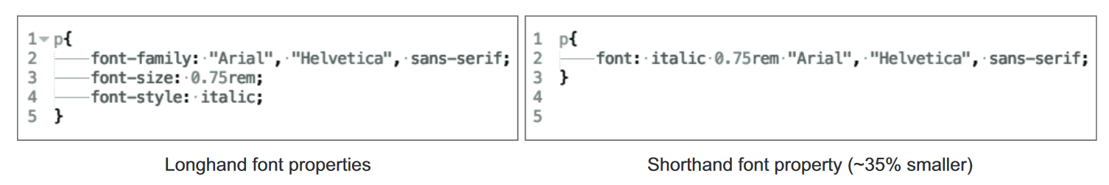
Write shorthand CSS
Using shorthand CSS means using the least verbose properties and values where possible. the rule on the left uses a set of verbose typography styles that takes up 94 bytes, and the rule on the right combines them into a single font property that takes up 60 bytes.

Slide 4
The following is a guide for shorthand properties using this syntax:
Use one value when all four sides of an element have the same value. If all four sides of an element have a margin of 20px, you can abbreviate to margin: 20px;.
Use two values when the top/bottom and right/left values are the same. If an element has a margin of 10px on the top and bottom sides, and 20px on the right and left sides, you can abbreviate to margin: 10px 20px;.
Use three values when only the right/left values are the same, but the top and bottom values are different. If an element has a top margin of 10px, a right/left margin of 20px, and a bottom margin of 30px, you can write margin: 10px 20px 30px;.
Use all four values when all of the values are unique.

Slide 5
Ex.
background-color: #000;
background-image: url(images/bg.gif);
background-repeat: no-repeat;
background-position: left top;
Replace with-
background: #000 url(images/bg.gif) no-repeat left top;

Slide 6
Ex.
border-width: 1px;
border-style: solid;
border-color: #000;
Replace With-
border: 1px solid #000;

Slide 7
Use shallow CSS selectors
Shallowness refers to the specificity of a CSS selector. Overly specific selectors are those that are many levels deep, whereas shallow selectors are less so, specifying only what’s necessary to match an element.
In big style sheets, keeping CSS selectors brief can save space. By reducing complexity, you can keep style sheets lean and load times low, thus boosting the page’s performance.

Slide 8
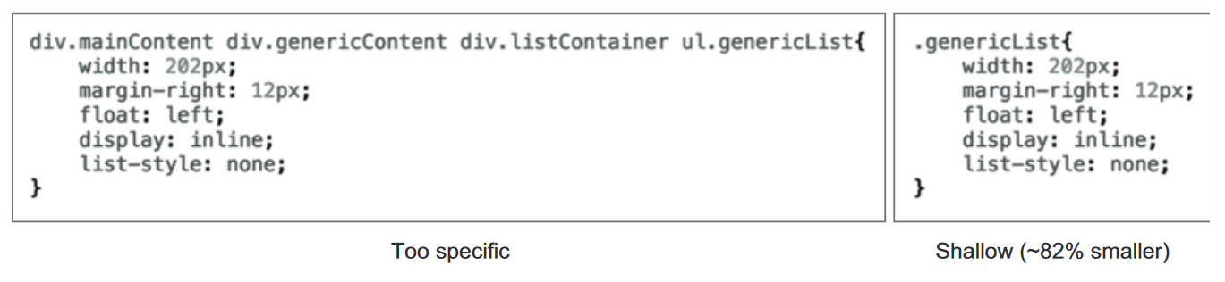
An example of an overly specific CSS selector (left) versus a more succinct one (right). The selector at the left is 67 characters, whereas the one at the right is at 12 characters.

Slide 9
uncss
Node program called uncss to remove all the unused CSS from the style sheet. With these two commands, you can install the program globally and run it against the CSS file from the root folder of the client’s site:
npm install -g uncss
uncss http://localhost:8080 -i .modal.open > css/styles.clean.css
This command takes an argument for a URL. In this case, you’re telling the program to look at the client website that you’re running locally. The -i option is an argument you use to tell the program which selectors you should keep. In this case, you want uncss to leave alone the .modal.open class that slides the modal window into view.

Slide 10
LESS and SASS
Precompilers provide features not available in plain CSS , including variables, functions (called mixins) for reuse of styles, and importing capabilities to help make your CSS more modular.
These tools then compile files written in the precompiler language down to plain CSS that can be understood by the browser.
Popular precompilers are LESS (http://lesscss.org) and SASS (http://sass-lang.com).

Slide 11
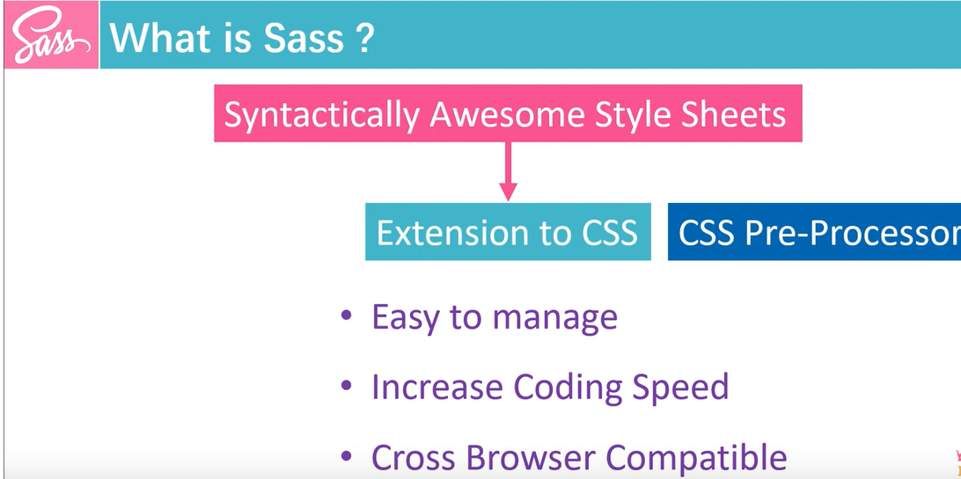

Slide 12
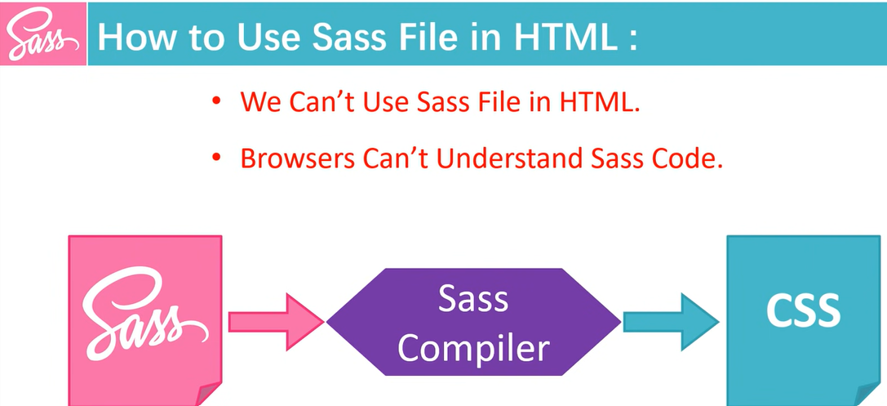

Slide 13
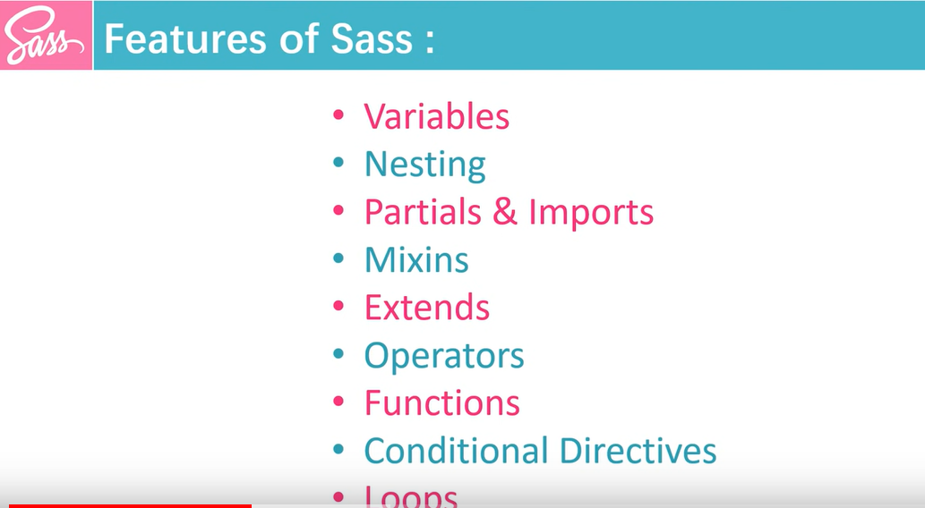

Slide 14
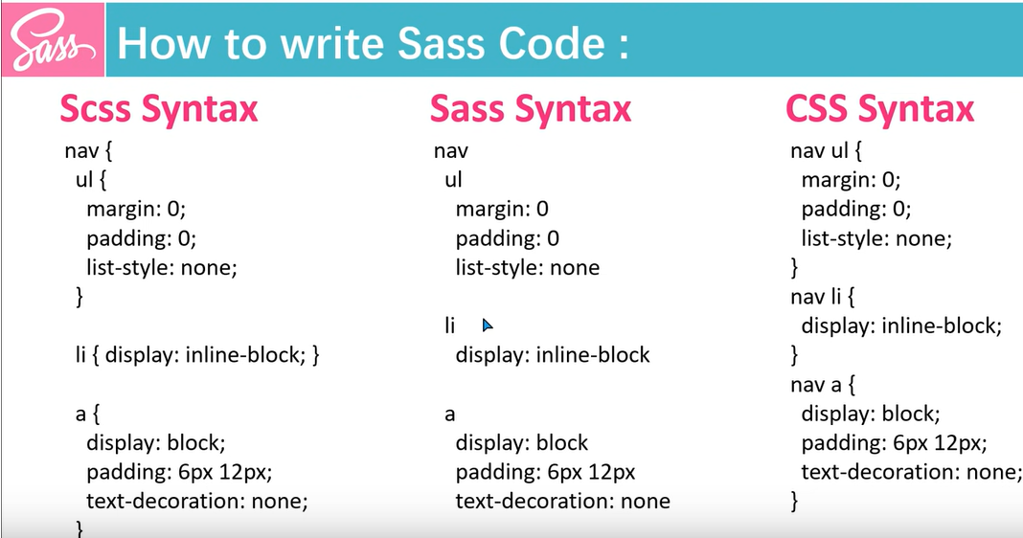

Slide 15
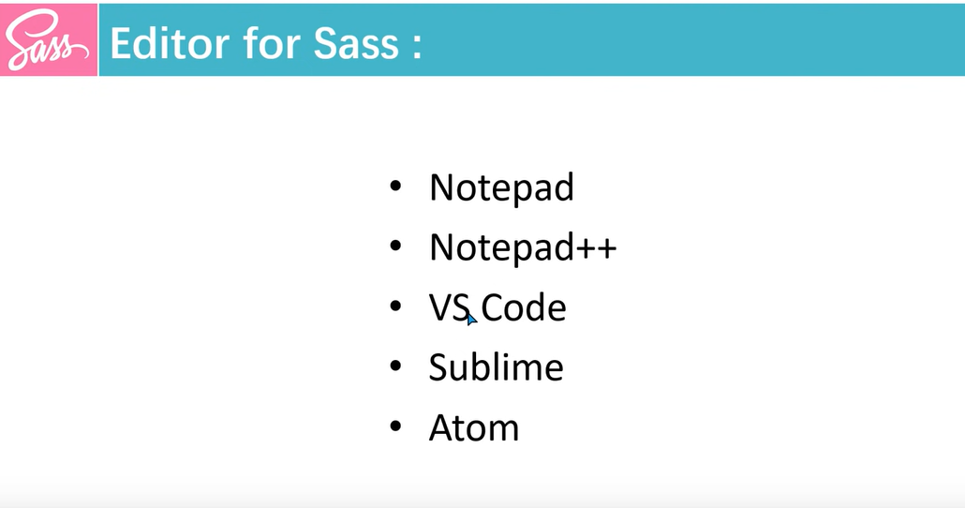

Slide 16
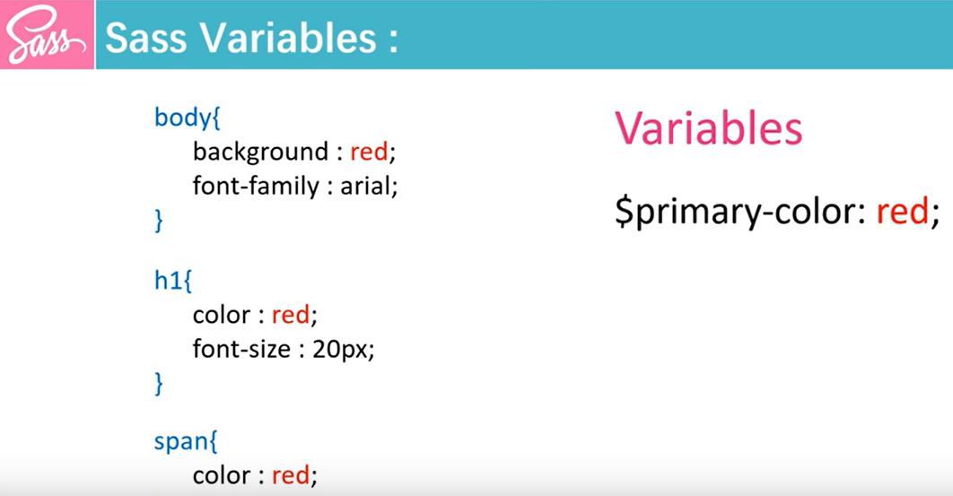

Slide 17
Variables
These are pretty self-explanatory:
$width: 10px;
$height: $width + 10px;
#header {
width: $width;
height: $height;
}
Outputs:
#header {
width: 10px;
height: 20px;
}

Slide 18
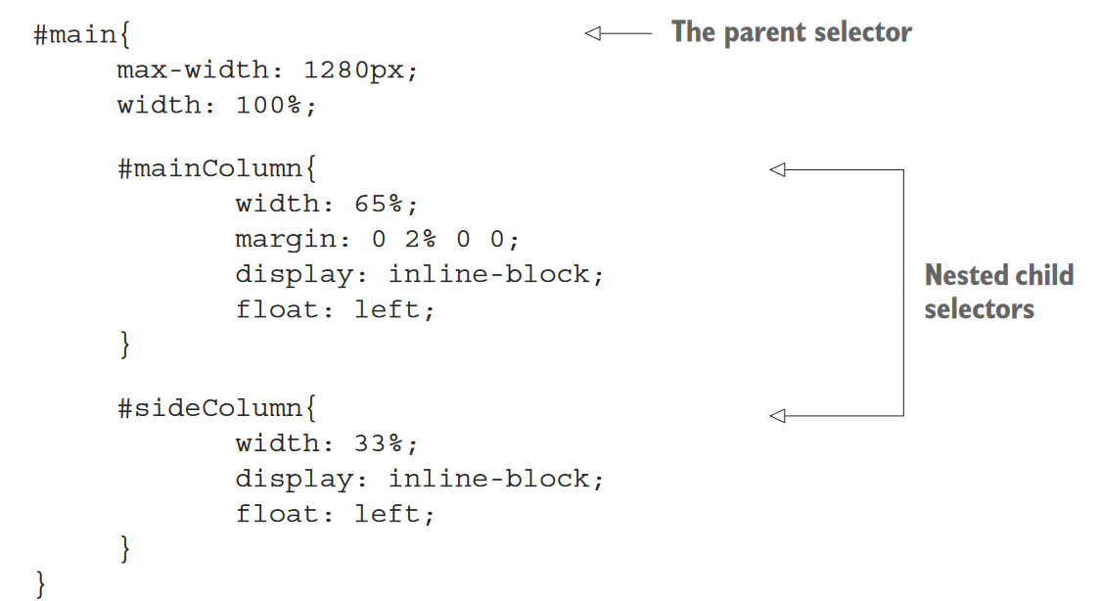
LESS and SASS selector nesting
If you use these tools instead of writing plain CSS , you may be taking advantage of a nested selector feature.
This looks nice, but it’s more of a service to the developer than anything else. It is
more readable, because it mimics the hierarchical structure of the HTML, but this convenience comes at a performance cost.

Slide 19
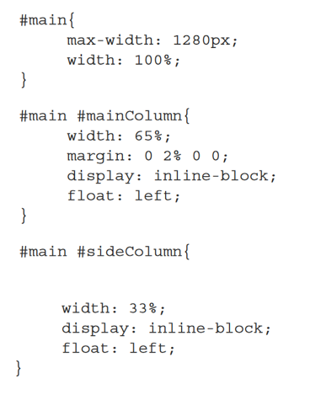
LESS/SASS nested selectors after compilation
When this code is compiled into plain CSS, it looks like this.
After compilation, the CSS selectors are too specific because of the nesting in the original LESS/ SASS code.
In this case, every child of #main is now too specific.
The deeper this nesting goes, the more problematic it’ll be.
Compression and minification do mitigate this somewhat, but these overly specific selectors can slow rendering time as well.

Slide 20
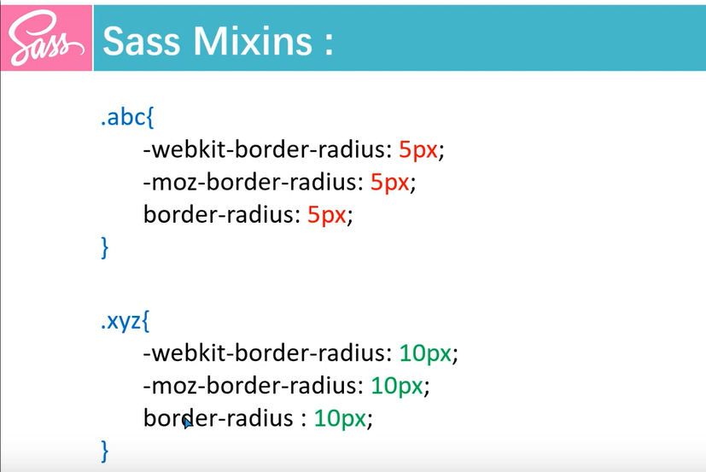

Slide 21
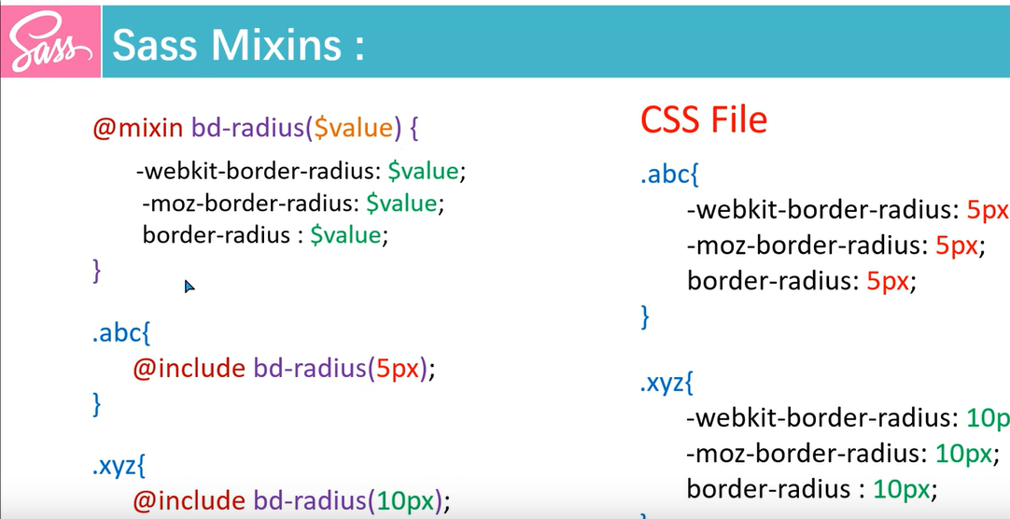

Slide 22
Don’t repeat yourself
Another problem that front-end developers encounter in CSS is that properties are often duplicated across selectors.
An example is multiple selectors that specify the same background color or font style.
By minimizing the number of times a property is declared, you can cut down on bloat and make your CSS more maintainable.

Slide 23
Going DRY
The DRY principle is simple in that it seeks to reduce redundancy in CSS wherever practical and possible.
Two selectors contain identical background rules. DRY dictates that you should combine these not only to save space, but also to provide increased maintainability.
One method for finding redundancy is to look at common rules and combine them under multiple selectors.

Slide 24
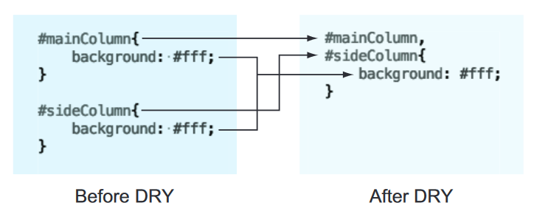
An example of the DRY principle. Two selectors have the same background property. To save space and
eliminate redundancy, the background property and the selectors are combined.

Slide 25
Finding redundancies with csscss
csscss is a command-line tool that finds redundancies in your CSS . To install csscss, you need Ruby’s gem installer, which is similar to Node’s npm executable, but for Ruby packages. If you have SASS installed, gem is already available to you.
To install Ruby on Windows, go to http://rubyinstaller.org/downloads and grab the installer that’s right for your system.
Installing the software is a simple and guided process.
After Ruby is installed, you can install csscss with gem by typing in the following command:
gem install csscss
After a moment, the gem package manager will install csscss, and you’ll be able to run it against a CSS file.

Slide 26
Finding redundancies with csscss
Try running it on styles.css from the client’s site:
csscss styles.css –v –-no-match-shorthand
This command examines styles.css for redundant rules by using two arguments.
The -v argument tells the program to be verbose and print out the matching rules.
The --no-match-shorthand argument keeps the program from expanding any matching shorthand rules such as border-bottom into more-explicit rules such as border-bottom-style. If you want to expand those rules, remove that switch.

Slide 27
A portion of csscss output
{#okayButton}, {#schedule} AND {.submitAppointment a} share 12 declarations
- background: #c40a0a
- border-bottom: 4px solid #630505
- border-radius: 8px
- color: #fff
- display: inline-block
- font-size: 20px
- font-weight: 700
- letter-spacing: -0.5px
- line-height: 22px
- padding: 12px 16px
- text-decoration: none
- text-transform: uppercase

Slide 28
This rule is a good one to start with, because the CSS for these selectors is consistent on all devices.
From here, you’ll employ a lather-rinse-repeat methodology starting from the top.
By the end of this short exercise, you’ll be able to shave off an additional 10% from styles.css.
Do the following for above example:
1. Combine selectors and rules—Combine the selectors #okayButton, #schedule, and .submitAppointment a into a single, comma-separated selector, and copy/paste the suggested rules from the program output.

Slide 29
Combined CSS rule from csscss output
#okayButton, #schedule, .submitAppointment a{
background: #c40a0a;
border-bottom: 4px solid #630505;
border-radius: 8px;
color: #fff;
display: inline-block;
font-size: 20px;
font-weight: 700;
letter-spacing: -0.5px;
line-height: 22px;
padding: 12px 16px;
text-decoration: none;
text-transform: uppercase;
}

Slide 30
2. Clean up the matching rules from the individual selectors—Go back and remove the redundant rules from the original #okayButton, #schedule, and .submitAppointment a selectors.
3. Rerun csscss, examine the output, and repeat—After you’ve cleaned up the redundant rules in the old selectors, rerun csscss to verify that the rule you’ve optimized is stricken from the list.

Slide 31
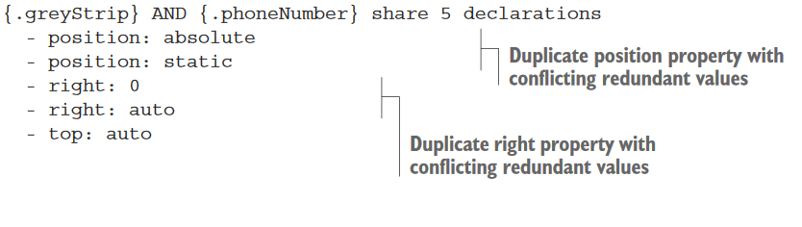
Problematic csscss output
The best approach for responsive sites is to combine values that are common across all breakpoints.

Slide 32
Segment CSS
One way to optimize your CSS is to segment it. Segmentation splits up CSS by styles specific to particular page templates.
It can make sense to combine all of your site’s CSS into one file so that the user already has all of the site’s CSS cached on the first visit.
Serving your CSS this way can be a gamble, however, because your users may never navigate to subpages.
This slows the initial visit to your site.
The safer bet is to spread the weight across a few pages, but intelligently.

Slide 33
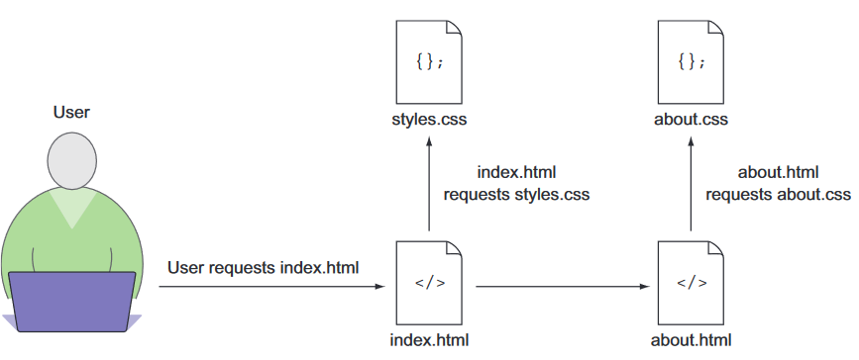
A data-driven method of determining how to segment your site’s CSS is to look at its analytics, and look at the path users take through your website.
With a tool such as Google Analytics, you can visualize this information and use it to make informed decisions on segmentation.
A user navigation flow to pages with CSS segmented by page template. The browser downloads only the CSS it needs for the current page.

Slide 34
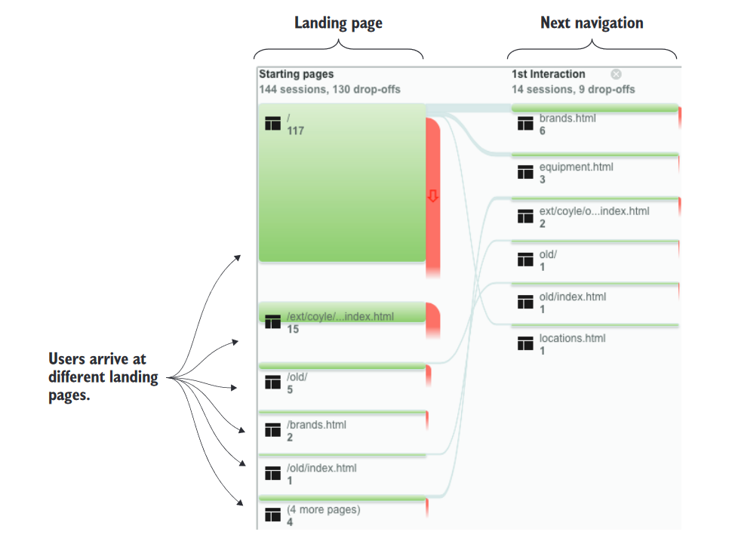
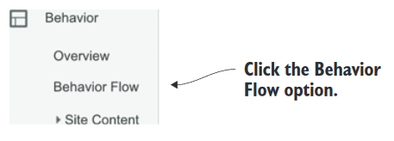
Logging into Google Analytics. Then find the visitor-flow information by navigating to the Behavior section in the left-hand menu, and selecting the Behavior Flow option in the submenu.

Slide 35
Customize framework downloads
CSS frameworks are a big part of the front-end development sphere, and with good reason.
They can be time-saving tools that offer a tremendous service to the developer.
If the benefit of using a CSS framework translates into a benefit for the user, they’re worth considering.
Popular frameworks such as Bootstrap and Foundation allow the developer to customize downloads.
You can have too much of a good thing, though, and it makes sense to prune what you don’t need from these libraries.

Slide 36
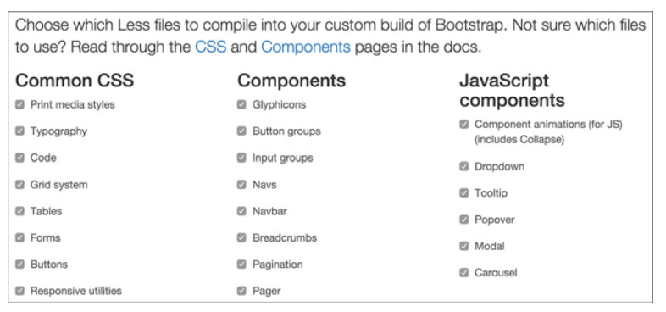
The download customization screen on the Twitter Bootstrap website. Bootstrap allows the developer to specify which parts of the framework the user wants in a custom download
After downloading the customized framework code, don’t be afraid to go further and remove anything else you don’t need.

Slide 37
Mobile-first is user-first
In years past, front-end development has gone from a simple discipline to a more nuanced one.
This is due in part to the emergence of the responsive web design principle pioneered by designer Ethan Marcotte.
In the past, developers would create separate sites for mobile devices with fewer capabilities than their desktop counterparts.
This approach has fallen out of favor, with developers embracing responsive web design instead.
Responsive web design uses one set of markup and modifies its presentation via CSS with respect to the device’s display dimensions.
These dimensions (usually the width) are examined by using a media query, and evaluated against a min-width or max-width value.
Because media queries are flexible, two methods of responsive web design arose: desktop-first and mobile-first responsive design.

Slide 38
@media only screen and (max-width: 600px) {...}
What this query really means is, “If [device width] is less than or equal to 600px, then do {...}.
@media only screen and (min-width: 600px) {...}
What this query really means is, “If [device width] is greater than or equal to 600px, then do {...}“.
@media only screen and (max-width: 600px) and (min-width: 400px) {...}
The query above will trigger only for screens that are between 600px and 400px wide.
The breakpoint is the screen width at which the design and layout of an HTML email or a web page will adapt to provide an optimal viewing experience.

Slide 39
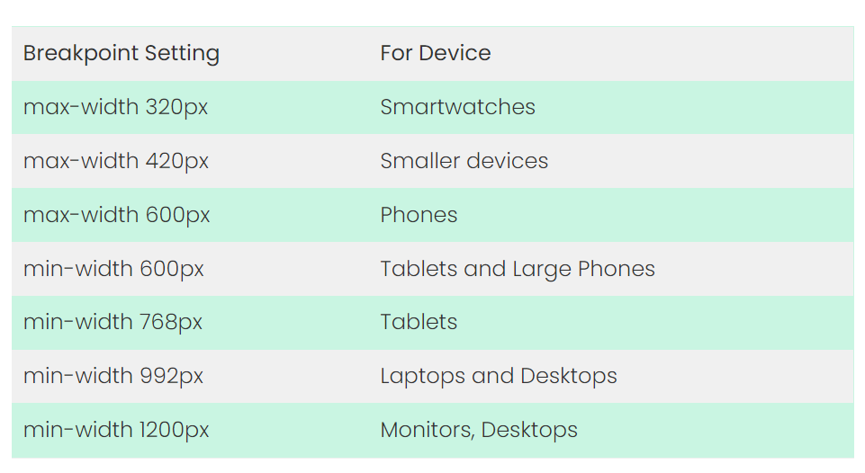

Slide 40
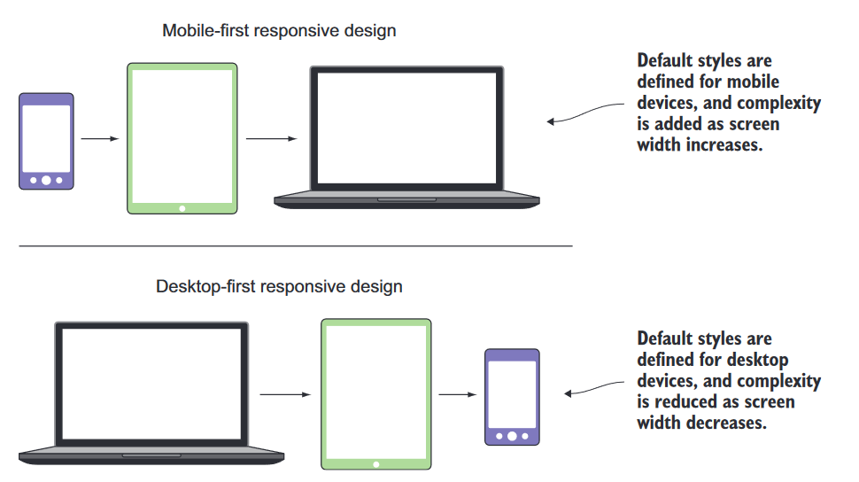
Mobile-first vs. desktop-first
Using the mobile-first method, the default appearance is the mobile version of the site.
In desktop-first sites, the default appearance is the desktop version of the site.

Slide 41
The advantage of mobile-first CSS is that you’re serving CSS intended for the devices that are most likely to consume it.
Because mobile devices often have less processing power and memory than desktop devices, the mobile device shouldn’t have to apply desktop styles, interpret media queries, and then apply mobile styles.
The benefit is in the ability to scale up as you go, rather than scaling down. If you start from the point of least complexity, you can optimize much more easily than if you remove pieces as you scale down.
Most of the time you’ll develop for three device types: mobile phones, tablets, and desktops.
All of these except for the foundational CSS lie within their own media query (commonly referred to as a breakpoint). A media query is a particular point in which new styles are applied. This point is typically a change in the screen’s width. In the case of mobile-first CSS, the mobile styles are the foundation, whereas the tablet and desktop are the breakpoints where changes in the layout occur.

Slide 42
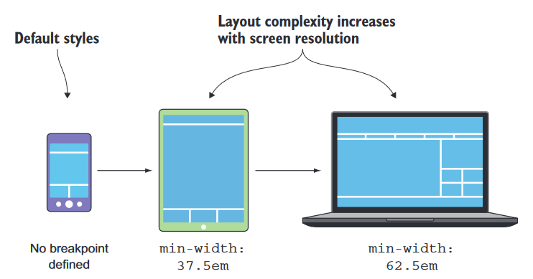
Breakpoints are set using em units rather than px units.
An em is a relative unit that’s calculated based on the document’s default font-size value (typically, 16px).
Calculating em values is done with a simple formula:
px / default font size = em
In this case, the tablet breakpoint of 600px is divided by the default document font-size of 16px to arrive to a value of 37.5em.
The desktop breakpoint of 1000px is converted using the same formula to a value of 62.5em.

Slide 43
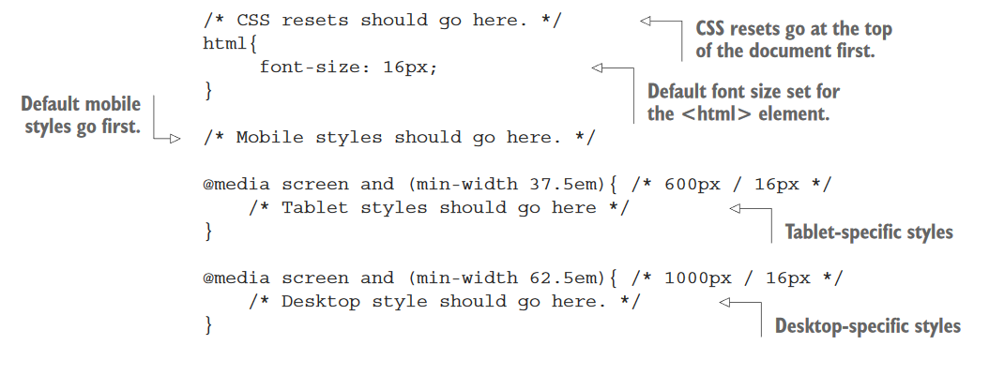
Mobile-first CSS boilerplate

Slide 44
At this point, you’ll include your CSS as you normally would inside a <link> tag.
To ensure that devices properly display your fancy new responsive CSS , you should add the following <meta> tag inside your <head> element:
<meta name="viewport" content="width=device-width,initial-scale=1">
This <meta> tag tells the browser two things: that the device should render the page at the same width as the device’s screen, and that the initial scale of the page should be 100%.

Slide 45
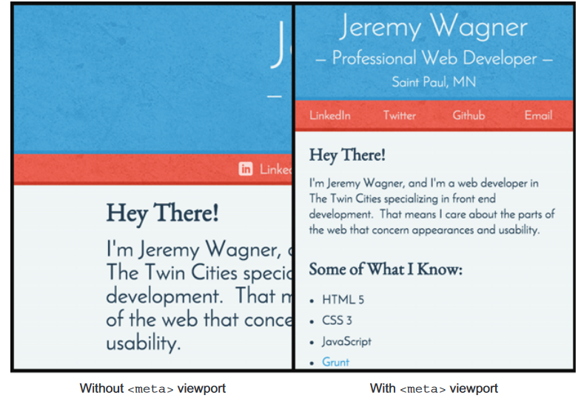
Using Google’s mobile-friendly guidelines
When Google looks at your site, it’s looking for two indicators of a good mobile user experience.
A properly configured viewport—As discussed earlier, the <meta> viewport tag is used by browsers to size content to the device’s screen.
Responsiveness—A site needs to respond to the size of the viewport as it changes. Users are fine with vertical scrolling, but horizontal scrolling is usually a bad user experience, and Google checks that content fits on a device’s screen without horizontal scrolling.

Slide 46
Verifying a site’s mobile-friendliness
Google developed the Mobile-Friendly Test tool, available at https://www.google.com/webmasters/tools/mobile-friendly/
This tool prompts the user to enter a URL to be analyzed.
After the site is analyzed, you’ll see that it passes the mobile-friendly test, and a success message is shown.
For sites that aren’t mobile-friendly, the tool will return a list of reasons that the site failed the test, along with next steps for correcting issues.

